Slide 1
SQLITE
Giảng viên: Trương Thị Ngọc Phượng
Notes:
https://www.tutorialspoint.com/android/android_grid_view.htm
https://www.tutorialspoint.com/android/android_list_view.htm
https://www.raywenderlich.com/124438/android-listview-tutorial

Slide 2
content
What is SQLite?
Database Creation
Database Insertion
Database Fetching
Database HelperClass

Slide 3
content
What is SQLite?
Database Creation
Database Insertion
Database Fetching
Database HelperClass

Slide 4
What is sqlite?
SQLite is an opensource SQL database that store data to a text file on device.
Android comes in with built in SQLite database implementation.
SQLite supports all the relational database features.
In order to access this database, you don’t need to establish any kind of connections for it.
The main package is android.database.sqlite.

Slide 5
content
What is SQLite?
Database Creation
Database Insertion
Database Fetching
Database HelperClass

Slide 6
DATABASE CREATION
SQLite is an opensource SQL database that store data to a text file on device.
SQLiteDatabase mydatabase = openOrCreateDatabase(”database_name”, MODE_PRIVATE, null);

Slide 7
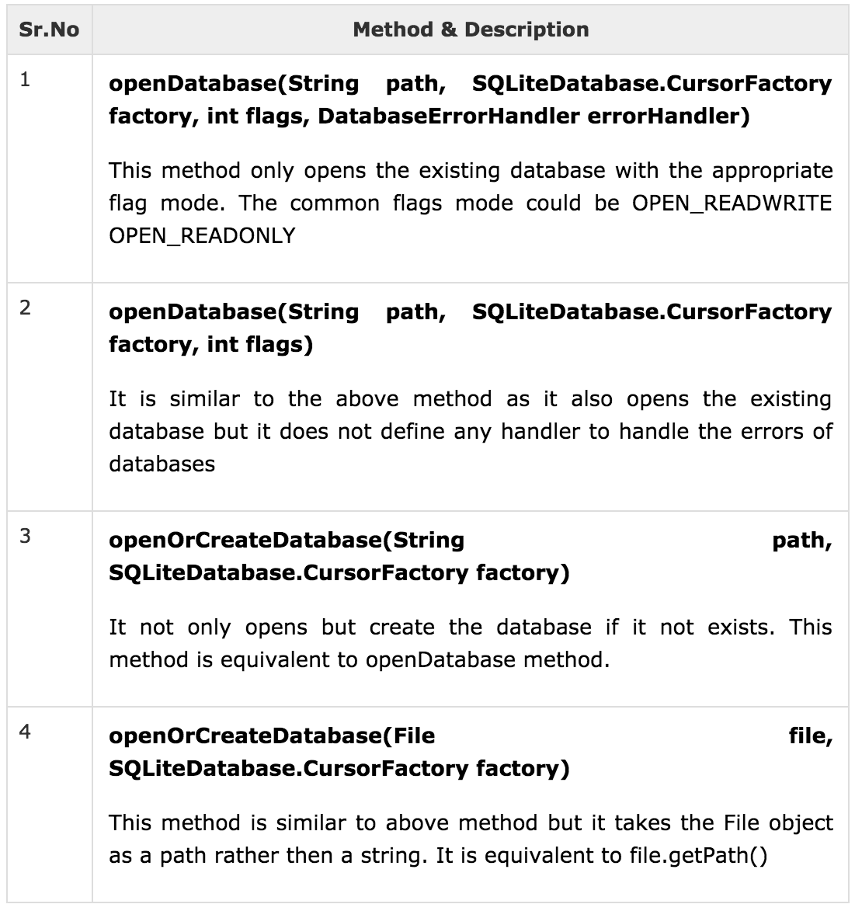
DATABASE CREATION

Slide 8
content
What is SQLite?
Database Creation
Database Insertion
Database Fetching
Database HelperClass

Slide 9
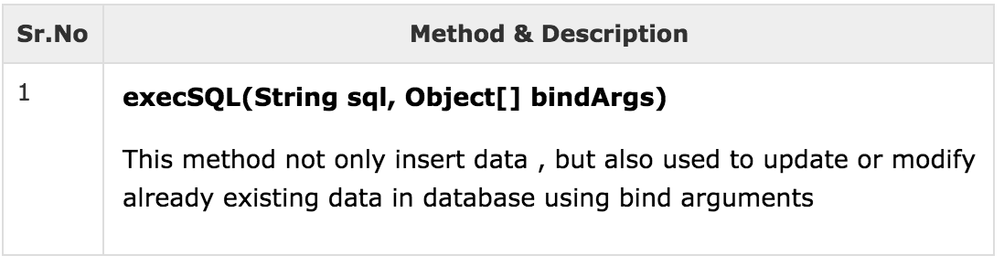
DATABASE INSERTION
Create Table or Insert data into table using execSQL() method. Its syntax is given below:
mydatabase.execSQL(”CREATE TABLE IF NOT EXISTS TutorialsPoint(Username VARCHAR, Password VARCHAR);”);
mydatabase.execSQL(”INSERT INTO TutorialsPoint VALUES(’admin’, ‘admin’);”);

Slide 10
content
What is SQLite?
Database Creation
Database Insertion
Database Fetching
Database HelperClass

Slide 11
DATABASE fetching
We can retrieve anything from database using an object of the Cursor class.
Call method rawQuery() → return a resultset with the cursor pointing to the table.
We can move the cursor forward to retrieve data.
Cursor resultSet = mydatabase.rawQuery(”Select * from TutorialsPoint", null);
resultSet.moveToFirst();
String username = resultSet.getString(0);
String password = resultSet.getString(1);

Slide 12
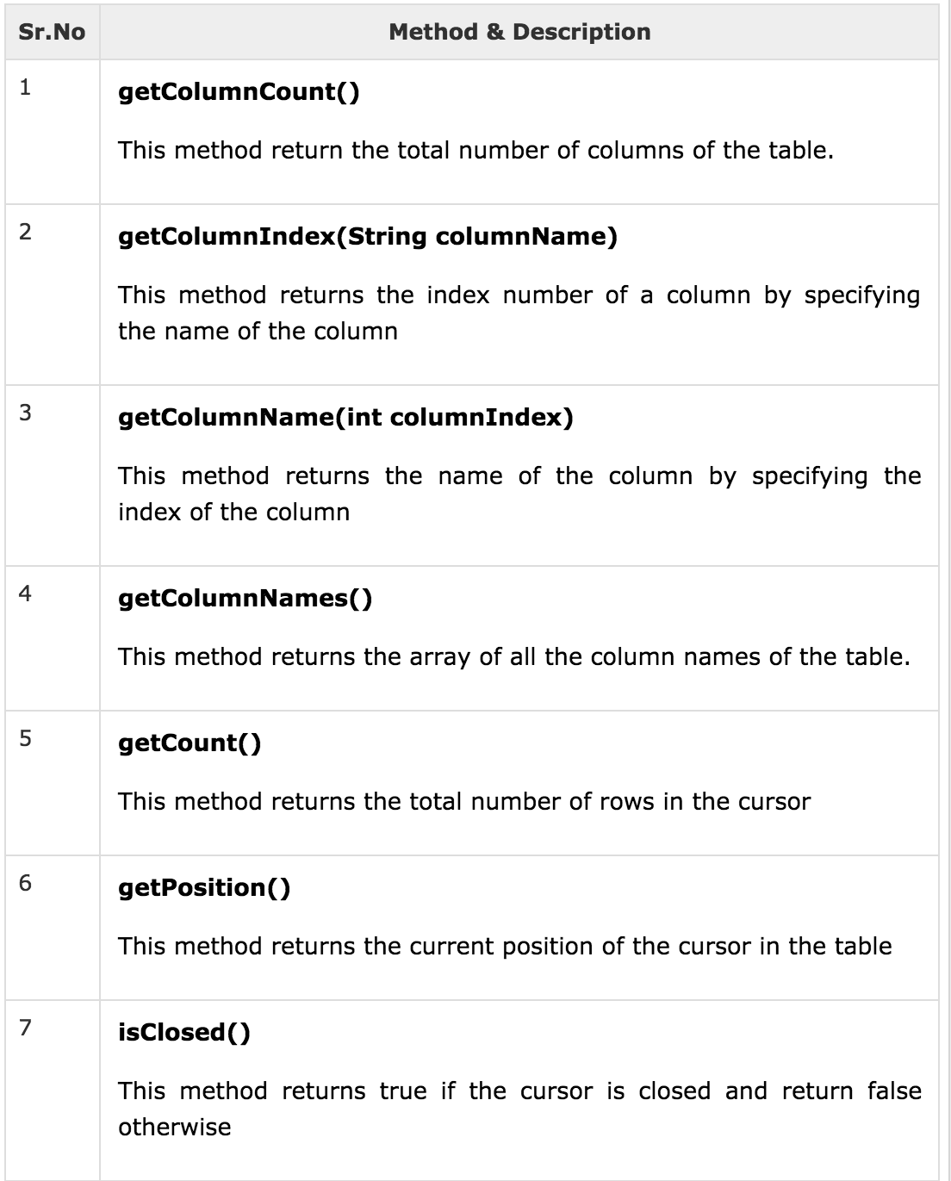
DATABASE fetching

Slide 13
content
What is SQLite?
Database Creation
Database Insertion
Database Fetching
Database HelperClass

Slide 14
DATABASE HELPERCLASS
For managing all the operations related to the database, an helper class has been given and is called SQLiteOpenHelper → automatically manages the creation and update of the database.
Syntax below:
public class DBHelper extends SQLiteOpenHelper{
public DBHelper(){
super(context, DATABASE_NAME, null,1);
}
public void onCreate(SQLiteDatabase db){}
public void onUpgrade(SQLiteDatabase database, int oldVersion, int newVersion)P{}
}

